Slide 1


Scientifically Research Institute Interecoms - Consulting company of United Nations Industrial Development Organization 27 years in Russia and international markets
WWW.INTERECOMS.RU

Slide 2
United Nations Industrial Development Organization UNIDO
Certificate
SRI «Interecoms» is the member of the register " Academic and research institutions “ of United Nations Industrial Development Organization

Slide 3
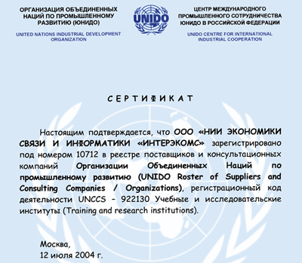

Slide 4
SRI "Interecoms" interacts with authorities
Federation Council of Federal Assembly of the Russian Federation
State Duma of the Federal Assembly of the Russian Federation
Federal Antimonopoly Service of the Russian Federation
Rosstandart
Ministry of Economic Development of the Russian Federation
Rostekhnadzor
Ministry of digital development, communication and mass communications of the Russian Federation, etc.

Slide 5
Interaction with national technical committees Rosstandart
TC 100 "Strategic Management and Innovation"
TC 21 "Communication services, informatizations, the organization and management of communication, construction and operation of objects in the sphere of communication and information technologies"
TC 20 "Ecological management and economy"
TC 123 "Personnel management and anti-corruption activities"

Slide 6
The Scientific magazine
"Century of quality"
Directions
- Economy and management of the national economy
- Systems, networks and devices of telecommunications
- Theory and history of the right and state; story of exercises about the right and state
Included in the list of HAC journals

Slide 7
Organization of interaction with public authorities
XXX International Congress "Safety, quality, economics of the information society"
6 June 2018
XIX International conference "Strategy and practice of successful activity"
21-30 September 2018

Slide 8
Group of Companies "Interecoms"
Scientifically Research Institute"Interecoms“
Certification Body of management systems "Interecoms“
Center of certification of services and information technologies
International Institute of quality of business

Slide 9
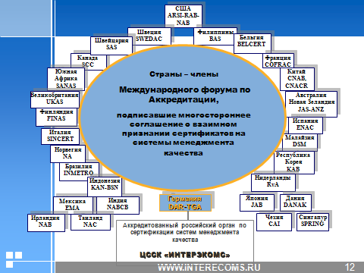
Recognition of certificates СВMS "Interecoms"

Slide 10
Аctivities in the field of technical regulation
SRI "Interecoms"
Development of standards
Assessment of compliance of services, systems of management
Development of indicators, standards
Standard and methodical providing

Slide 11
Activities of "Interecoms" Management and development of business Improvement of business processes Assessment of efficiency of investment projects

Slide 12
Certification Body of management systems "Interecoms"
National certification system GOST R
National Integrated Management System «RSM»
System of voluntary certification "Interecoms"
System of the international certification DAkkS
Certification of systems of anti-corruption management

